Slide 1


Spoke-Darts for High-Dimensional Blue-Noise Sampling
Scott A. Mitchell ACM TOG 37:2, May 2018 Scott A. Mitchell, Mohamed S. Ebeida, Muhammad A. Awad, Chonhyon Park, Anjul Patney, Ahmad A. Rushdi, Laura P. Swiler, Dinesh Manocha (now UMD), Li-Yi Wei

Slide 2
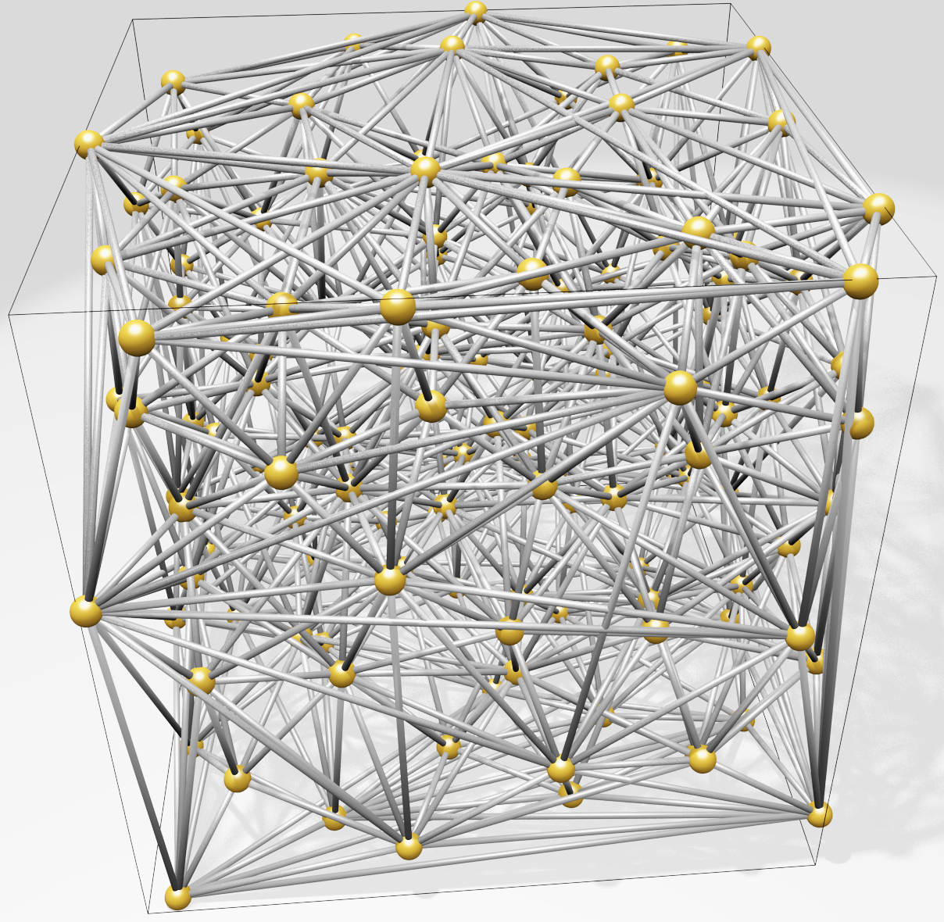
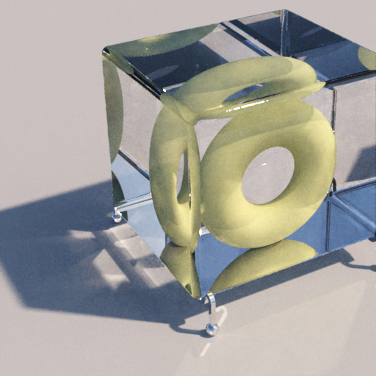
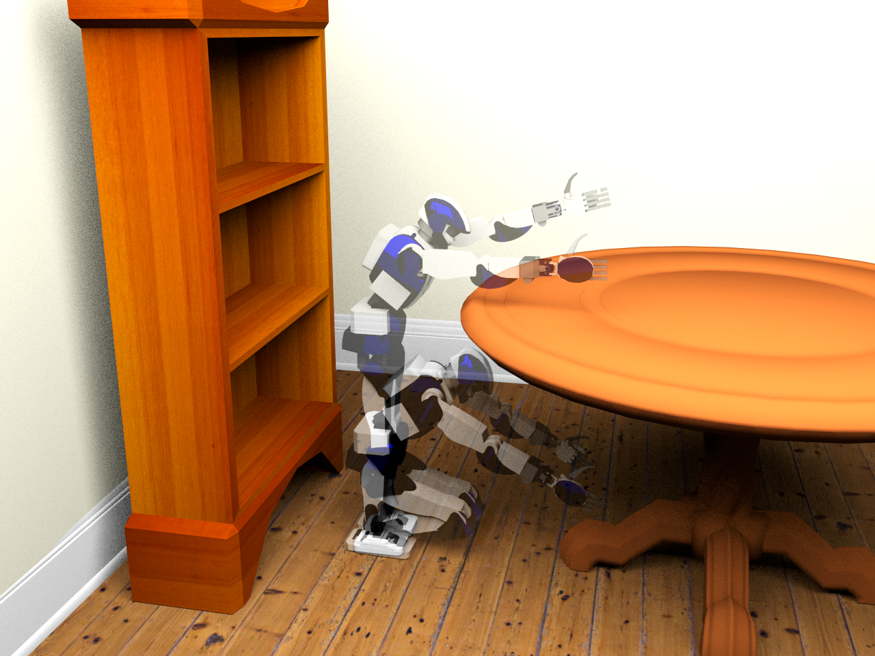
Motivation
Blue-noise sampling is useful but hard to generate in high-dimensions especially adaptively!
Render
Geometry
8-100D: approximate Delaunay Graphs (Voronoi neighbors)
8D: proof-of-concept path tracing
23D: find a path in robot configuration space
Motion Plan
Optimize
100D: adaptively explore black-box function to find global minimum

Slide 3


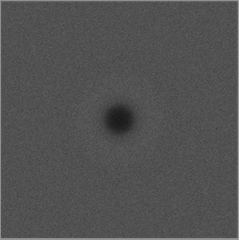
Motivation
Maximum
domain-to-sample distance
Goal: algorithm to produce point distributions
Requirements
Output: blue-noise, uniform-random point distribution except
No points too close
No big gaps
Process
Memory & time scales well to high dimensions (e.g. 20D)
Locally adaptive, general domain shapes
Confidence: provable guarantees on output quality
Minimum sample separation
RP Radial Power
RDF Radial Distance Function

Slide 4
What’s wrong with the algorithms we already have?
SimpleMPS

